Slide 1
RMA Scheduler -- Example 1
Task set: T_{i} = (c_{i}, p_{i})
T1 = (2,4) and T2 = (1,8)
Schedulability check:
2/4 + 1/8 = 0.5 + 0.125 = 0.625 ≤ 2(√2 -1) = 0. 82
T₁¹
T₂¹
T₁²
0
2
3
4
6
8

Slide 2
RMS scheduler -- Example-2
Task set: T_{i} = (c_{i}, p_{i})
T1 = (2,4) and T2 = (4,8)
Schedulability check:
2/4 + 4/8 = 0.5 + 0.5 = 1.0 > 2(√2 -1) = 0. 82
Active Tasks :
{T2}
Active Tasks :
{T2, T1}
Active Tasks :
{T2}
Active Tasks :
{T1, T2}
T₁¹
T₂¹
T₁²
T₂¹
0
2
3
4
6
8
Some task sets that FAIL the utilization-based schedulability test are also schedulable under RMS ➔ We need exact analysis.

Slide 3
Example 2
Check whether the following task set is schedulable using RMA:
  T1: e1 = 1, p1=4, d1=4
  T2: e2 = 2, p2=6, d2=6
  T3: e3 = 3, p3=20, d3=20

Slide 4
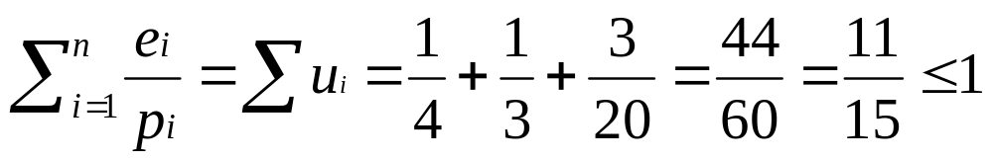
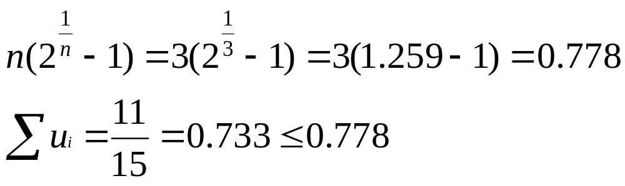
Solution to Example 1
Therefore the task set is schedulable.

Slide 5
A Basic Question
Construct an example for which EDF and RMA produce different schedules.
  Possibly simplest answer is:
    Consider a task set unschedulable in RMA but schedulable in EDF.
  A nontrivial example would be:
    Consider a task set in which a task is preempted before completion.

Slide 6
Example
T1: e1=3,p1=8
T2: e2=6, p2=12
RMA
RMA
T1
Τ2
T1
T1
Τ2
T1
3
8
11
3
8
11
12
12
EDF
T1
T2
T1
3
9

Slide 7
Liu and Layland Condition
The upper bound on utilization converges to 69% (ln2):
  As the number of tasks approaches infinity
Liu and Layland's condition is conservative:
  If a set of tasks passes Liu and Layland test, then it is definitely RMA schedulable.
  But, even if a task set fails Liu-Layland test:
    Still it may be RMA schedulable (completion time theorem).

Slide 8
Example 2
Check RMA schedulability of three periodic tasks:
  T1: e1=20mSec, p1= d1= 100mSec
  T2: e2=40msec, p2= d2= 150mSec
  T3: e3=100mSec, p3= d3= 350mSec
The utilization for these 3 tasks are
  0.2+0.267+0.286=0.753
Liu-Layland bound=3((2)^{1/3}-1) =0.779
  Therefore, the tasks are schedulable.

Slide 9
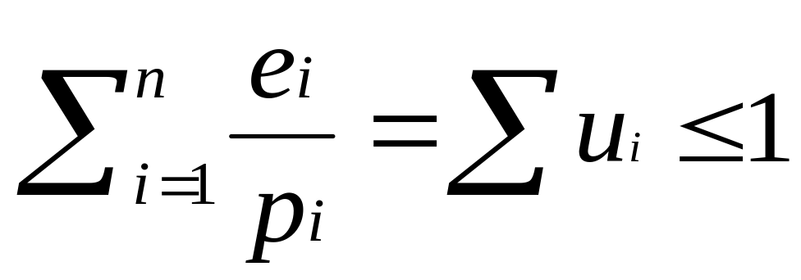
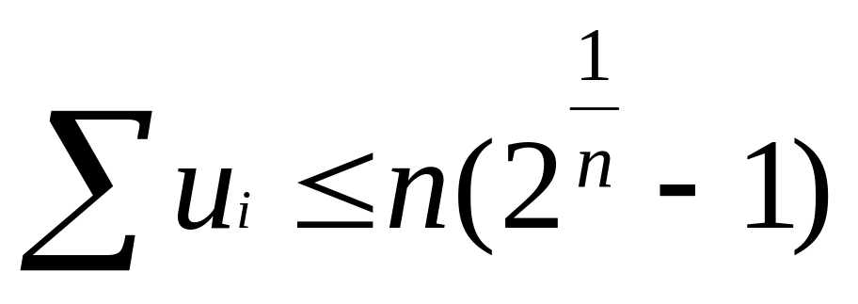
RMA Schedulability
Utilization bound 1:
Utilization bound 2:
(Liu-Layland)‏
Schedulability check 3: Liu and Lehoczky’s Completion Time Theorem
U2
U1

Slide 10
RMA Schedulability Test- III
Completion time theorem (Liu and Lehoczky 1989):
  If each of a set of tasks individually meets its first deadline under zero phasing:
    Then the task set is RMA schedulable for all task phasings.

Slide 11
Completion Time Theorem (Liu and Lehoczky)‏
How to check schedulability of a task set?
  Consider zero phasing for all tasks.
  Draw up the schedules till the first deadline of each task.
  Observe if each task is schedulable.
  Then the task set is schedulable.
Drawing the schedule is cumbersome:
  When the number of tasks is large.

Slide 12
Completion Time Theorem: Basic Premise
Worst case completion time for a task:
  Occurs when it is in phase with its higher priority tasks.
T1=10,30 Φ=0
T2=60,120 Φ=0
T₁
T₂
T₁
T₂
T₁
T₂
10
30
40
60
70
90
Time in milliseconds
(a) T₁ is in phase with T₂
T1=10,30 Φ=20
T2=60,120 Φ=0
T₂
T₁
T₂
T₁
T₂
20
30
50
60
80
Time in milliseconds
(b) T₁ has a 20 ms phase lag with T₂

Slide 13
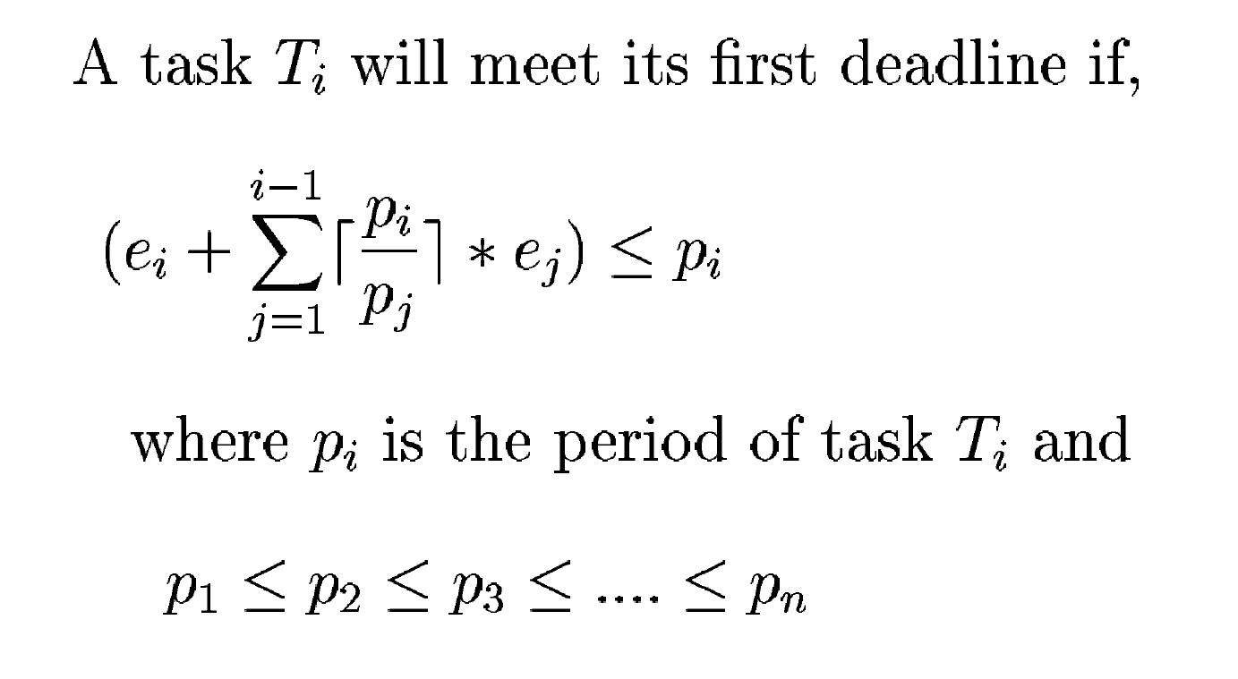
Testing Liu and Lehoczky's Criterion
03/08/10

Slide 14
Example 3
Consider three periodic tasks
  T1: e1=20mSec, p1=100mSec
  T2: e2=30mSec, p2=150mSec
  T3: e3=60mSec, p3=200mSec
Check whether they are RMA schedulable.

Slide 15
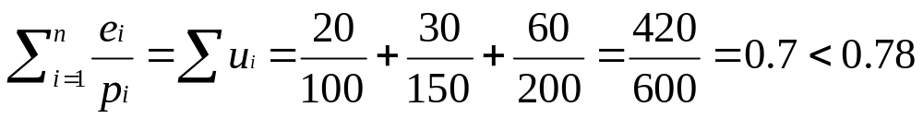
Answer 3
Checking for Liu-Layland criterion:
  The criterion satisfied:
  Therefore, the task set is schedulable.

